Slide 1
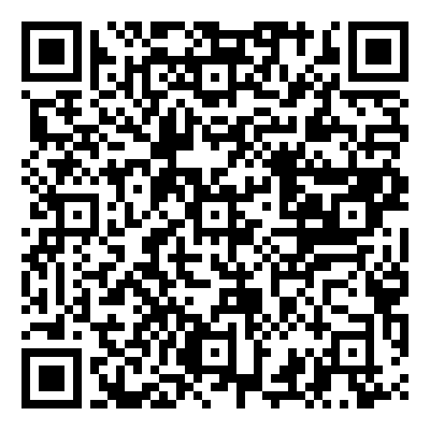
New Science Book Information from UNIV. CO-OP
Artificial General Intelligence
(MIT Press Essential Knowledge)
2024年8月
刊行予定
※大学生協洋書オンラインストアの該当商品のページへ
How to make AI capable of general intelligence, and what such technology would mean for society.
Artificial intelligence surrounds us. More and more of the systems and services you interact with every day are based on AI technology. Although some very recent AI systems are generalists to a degree, most AI is narrowly specific; that is, it can only do a single thing, in a single context. For example, your spellchecker can't do mathematics, and the world's best chess-playing program can't play Tetris. Human intelligence is different. We can solve a variety of tasks, including those we have not seen before. In Artificial General Intelligence, Julian Togelius explores technical approaches to developing more general artificial intelligence and asks what general AI would mean for human civilization.
Togelius starts by giving examples of narrow AI that have superhuman performance in some way. Interestingly, there have been AI systems that are superhuman in some sense for more than half a century. He then discusses what it would mean to have general intelligence, by looking at definitions from psychology, ethology, and computer science. Next, he explores the two main families of technical approaches to developing more general artificial intelligence: foundation models through self-supervised learning, and open-ended learning in virtual environments. The final chapters of the book investigate potential artificial general intelligence beyond the strictly technical aspects. The questions discussed here investigate whether such general AI would be conscious, whether it would pose a risk to humanity, and how it might alter society.
●著者Julian Togelius
●出版社The MIT Press
●ISBN 978-0-262-54934-9
●刊行2024/08
● Paper/240p
●人工知能
組合員価格は生協店舗にお尋ねください
＊海外からの仕入れのため為替レートの変動により価格は変動します。ご容赦ください。
注文書
Artificial General Intelligence ご注文 冊
氏名: TEL: お支払方法（○で囲む） 校費・私費
学部名； 学科名： 研究科or研究室名：
大学生協洋書オンラインストア
https://yosho.univcoop.jp/BookShop/
発行：2024年7月16日

